Slide 1
JSPM’S
IMPERIAL COLLEGE OF ENGINEERING & RESEARCH
WAGHOLI, PUNE -411207
DEPARTMENT OF COMPUTER ENGINEERING
CLASS: BE COMPUTER
YEAR: 2012-13
Cloud Computing Security From Single to Multi-Clouds
Group ID - 11
Group Member | Roll No.
Abhijeet Aralgundkar | 03
Rohit Karambali | 32
Tanaji Yetale | 74
Guided By:
Prof. Rajarshree Karande

Slide 2
Contents :
Introduction
Literature survey
Existing System
problem definition
Software Architecture
S/w & H/w Requirement
UML Diagram
SDLC and project plan
Conclusion
References

Slide 3
Introduction
What is Cloud Computing ?
Why it is term as Cloud ?
Problem of service unavailability in single Cloud.
This project will help to the end user as well as customer.

Slide 4
Literature Survey :
Name, Author and Publication | Methodologies | Advantages | Disadvantages
A Practical Guide to cloud computing Security By- Carl Almond August 2009 | Giving risk and mitigation | Security about the single cloud is maintained efficiently | Points only the security of single cloud
Security Challenges for public cloud By- Kui Ren, Cong Wang Jan 2012 | Outlineing Challangs & motivate further investigation | Address several security challenges That current research aren’t addressing | As maintaining security in public cloud ,urgency of data not comes into picture
Foundations and Properties of Shamir’s Secret Sharing Scheme By- Dan Bogdanov May 2007 | Encryption & Decryption | Excellent Framework From Proofs and Application | Properties related to Shamir’s Secrete Sharing

Slide 5
Existing System
Cloud ( most probably single cloud )
Makes low cost processing of data.
Gives delivery models as PaaS, SaaS, IaaS
Disadvantages:
Service availability failure
Possibility that there are malicious insiders in the single cloud.

Slide 6
Proposed System
Problem Definition :
As data storage and processing concern the cloud plays vital role. But along with this advantage develop a system which focus the security for single as well as multi-cloud. So for this purpose we have to develop the system which gives
1. Service Availability
2. Data Security
3. Data Integrity

Slide 7
Features :
Service Availability
Ability to run custom application using service providers resources
Data security
Data Integrity

Slide 8
Primary Objective :
Make the assurance that data is in secure and stable form.
Secondary objective :
Make service availability even when the one cloud fails
Handle Multiple request at a time.

Slide 9
Algorithm Analysis :
Secret Sharing Algorithms
Encryption:
Step1: input- secrete key k, number of participant n.
Step2: select random values a1,a2…,an.
Step3: Generate polynomial string to share the secrete into parts.
Step4: Secrete shared.
Decryption:
Step1: Generate polynomial string from secrete .
Step2: Add the n polynomial.

Slide 10
System Architecture :

Slide 11
S/W Requirement :
Operating System : Windows95/98/2000/XP
Application Server : Tomcat5.0/6.X
Front End : HTML, Java, JSP,AJAX
Scripts : JavaScript.
Server side Script : Java Server Pages.
Database Connectivity : Mysql.

Slide 12
H/W System Configuration :
Processor : Pentium –III
Speed : 1.1 GHz
RAM : 256 MB(min)
Hard Disk : 20 GB
Floppy Drive : 1.44 MB
Monitor : SVGA

Slide 13
Data Flow Diagrams :
Level 0 Data Flow

Slide 14
Level 1 Data Flow

Slide 15
ER Diagram :

Slide 16
Sequence Diagram :
Cloud Client
Cloud Administrator
End User
1 : Register()
2 : Request for Space
3 : Space Allocation()
4 : Login()
5 : Session Credentials
6 : Browse service offering
7 : List of service offering auth to user
8 : Get details & request service offering ID
9 : Service Offering, Supported Operation()
10 : Request for service()
11 : Forward Request of end user
12 : Processing()
13 : Reply to request

Slide 17
Class Diagram :

Slide 18
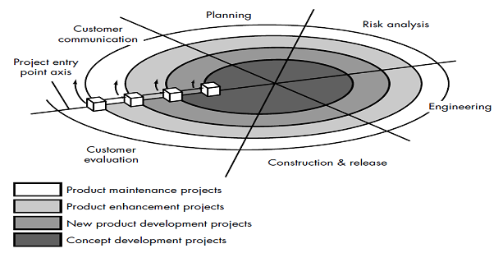
Life Cycle :

Slide 19
Advantages :
Data Integrity.
Service Availability.
The user runs custom applications using the service provider’s resources.
Cloud service providers should ensure the security of their customers’ data and should be responsible if any security risk affects their customers’ service infrastructure.

Slide 20
Disadvantages
Possibility of loss and change of data if cloud provider is not trusted.
privacy and security issues as a matter of high and urgent priority.

Slide 21
Project Plan
The objective of s/w project planning is to provide a framework that enables to make reasonable estimate of resources, cost and schedule
Sr.no | Activity | July | August | September | October
1 | Problem statement formation
2 | Requirement gathering
3 | Requirement analysis
4 | Learning Java, J2EE
5 | Generation of Use cases
6 | Identification of entity relationship
7 | Identification of Classes
8 | Learning FTP & FileZilla
9 | Implementation of administrator use case

Slide 22
Conclusion :
This project focuses on the issues related to the data security aspect of cloud computing. As data and information will be shared with a third party, cloud computing users want to avoid an untrusted cloud provider. Protection of user’s important data is the most significant part of this project.

Slide 23
References :
IEEE Transaction on :
Cloud computing security : from single to multi-cloud
Security Challenges for public cloud
Foundations and Properties of Shamir’s Secret Sharing Scheme

Slide 24
Thank You….!

